Slide 1
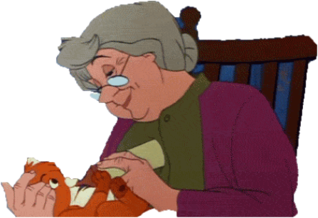
SMART BAND FOR SENIOR CITIZENS

Slide 2
PROBLEM & SOLUTION
PROBLEM:
Most of the senior citizens feel difficult to communicate with their family for the basic needs and frequently forget their daily medical schedule. Most of the senior citizens deaths are due to falling down.
SOLUTION:
A gesture based band that helps to convey message to the care-taker immediately and a remainder system for medical schedule. Also a speed calculating system that can prevent them from falling down.

Slide 3
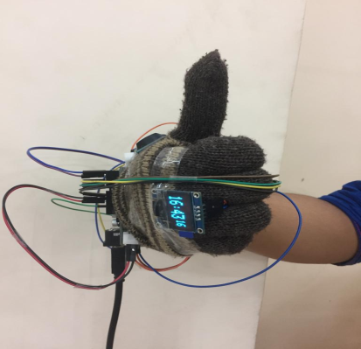
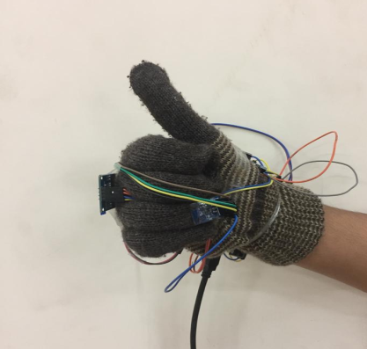
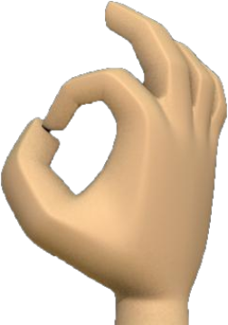
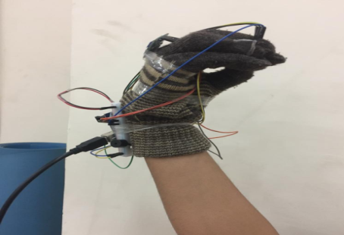
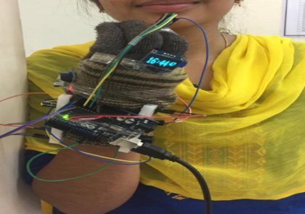
PRODUCT/SERVICE
Gesture based Messaging System
As soon as the senior citizens/bedridden people make some particular fixed gesture an SMS is sent through GSM module to the family members.
WATER
FOOD

Slide 4
2. Setting Remainders
Creating remainders for old people to take medicines, food etc. on time as most of the senior citizens forget things constantly.
3. Fall Prevention
According to a research, it was found that a gait speed decline of 5 cm/s was associated with a 86.3% probability of falling within the next 3 weeks. So by calculating the speed and number of steps taken by an old person thereby we can prevent him from falling down in near future. Further we would store the walking speed in an SD card and compare the data of 2 weeks. If the difference in the avg. walking speed is greater than 0.5 cm/s then we would report them to take care.
Reference of research : https://www.expresscomputer.in/news/how-iot-can-help-in-preventing-falls-for-senior-citizens/18926/

Slide 5
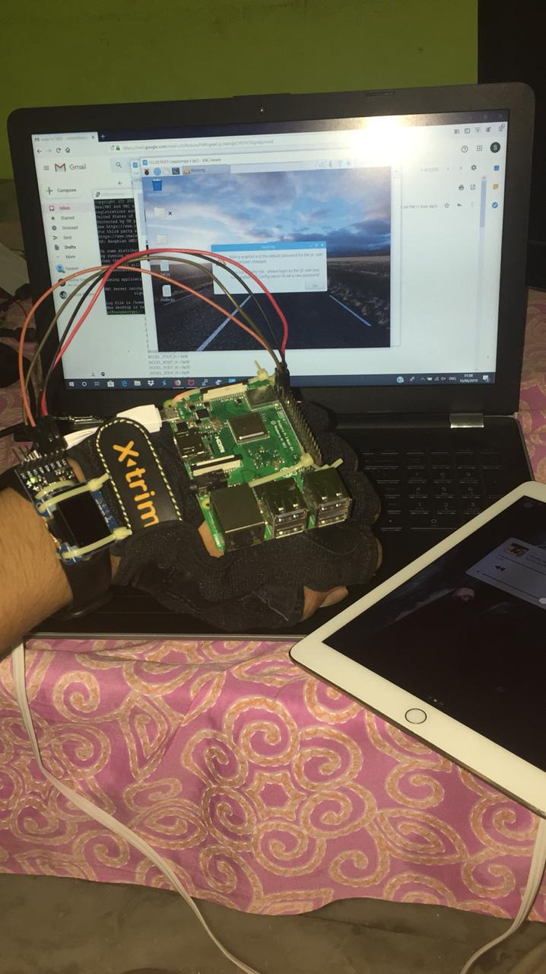
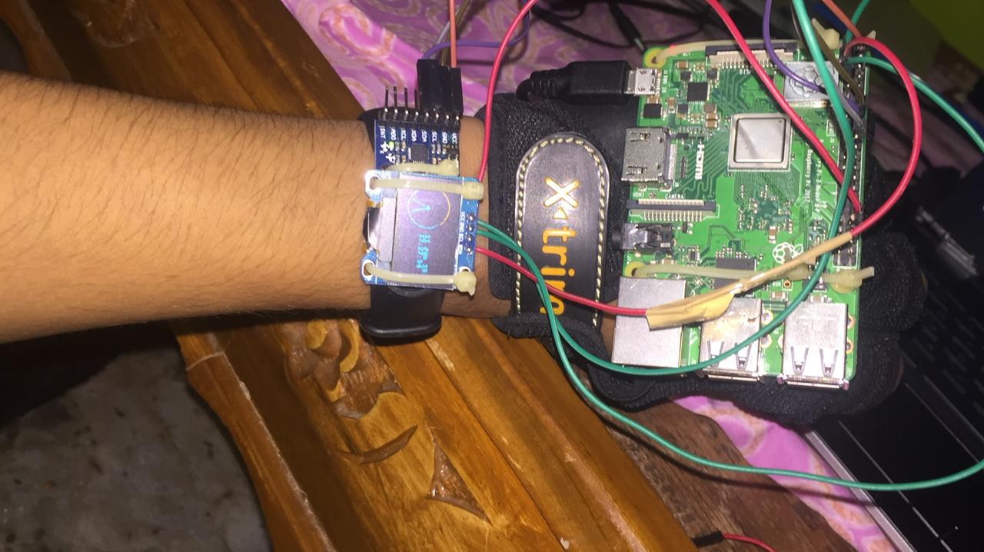
OUR PROJECT WORKING PROTOTYPE

Slide 6
MARKET
Our customers are
Hospitals
Medical shops
Old age homes
Care takers of old people
There are nearly 104 million elderly persons (aged 60 years or above) in India
Initially we can address 1/10th of the customers. We shall start from our city i.e., Hyderabad and then expand the business

Slide 7
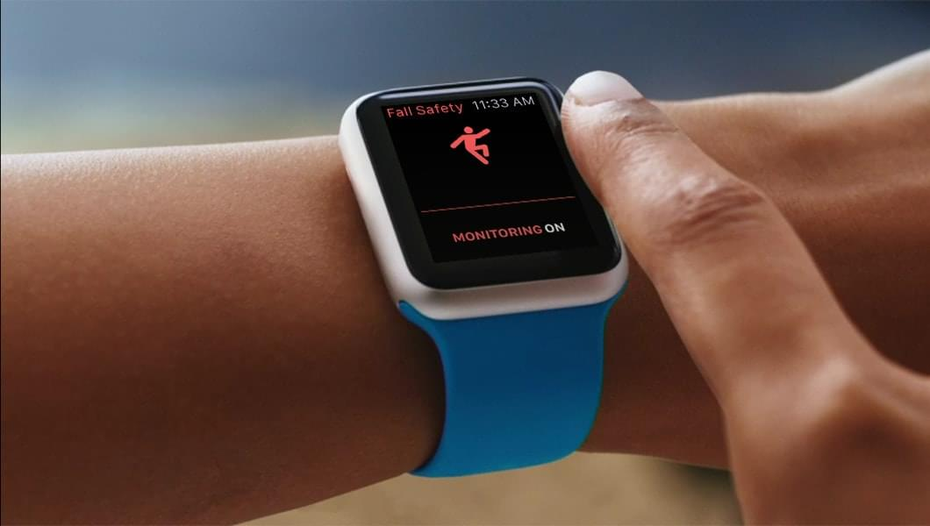
COMPETITION
Our only competitor is Apple Band.
Apple bands give us information only about Fall detection.
We have the feature of fall prediction and detection which gives us an upper hand and this way we are different from it.
The unique feature of our band is gesture based messaging system which doesn’t exist in any device.

Slide 8
MARKETING STRATEGY
Our customers are
Hospitals
Medical shops
Old age homes
Care takers of old people
We reach them through advertising, spreading information to people through doctors.
Online advertising, Social Media, Recommendation by Doctors/Medical shops etc., are the methods we will use for promoting our product.

Slide 9
MARKET RESEARCH
Created an online survey and considered those responses for the development of our project.
Visited an old age home in Nizampet to enquire how our project would be useful to the senior citizens.
We would also try to reach them through an online survey.

Slide 10
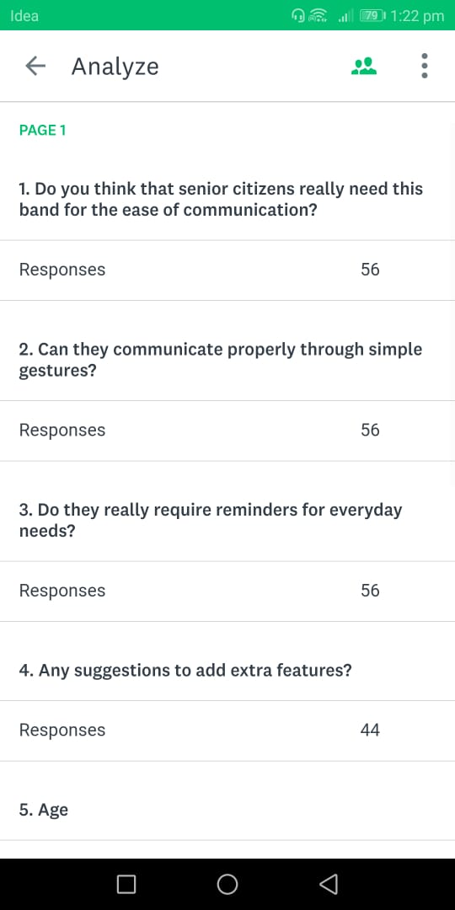
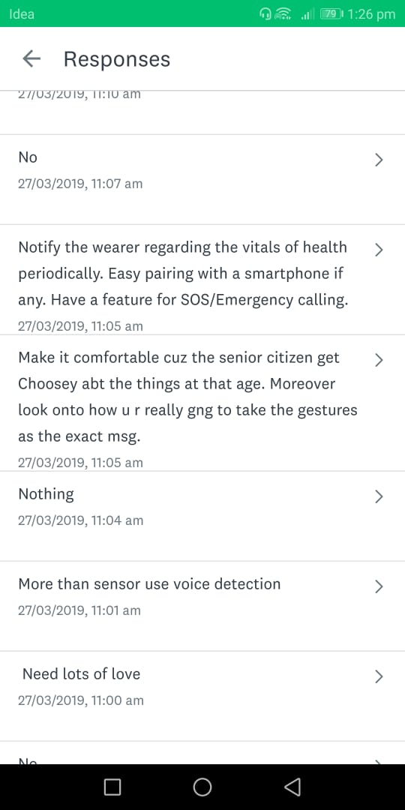
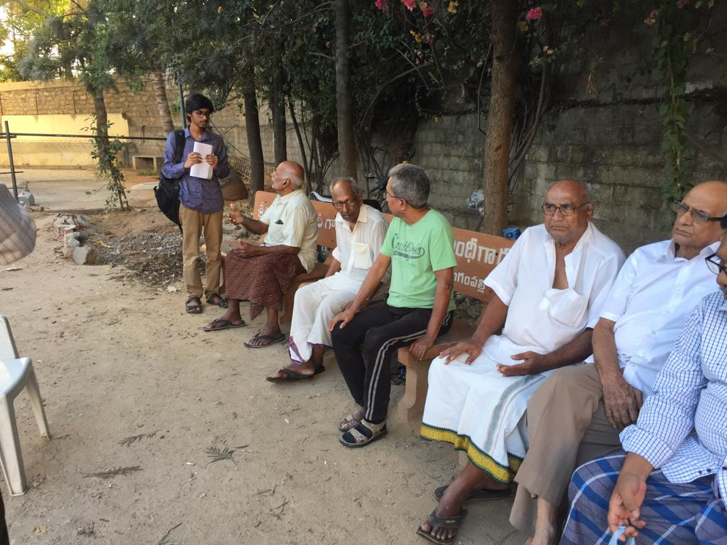
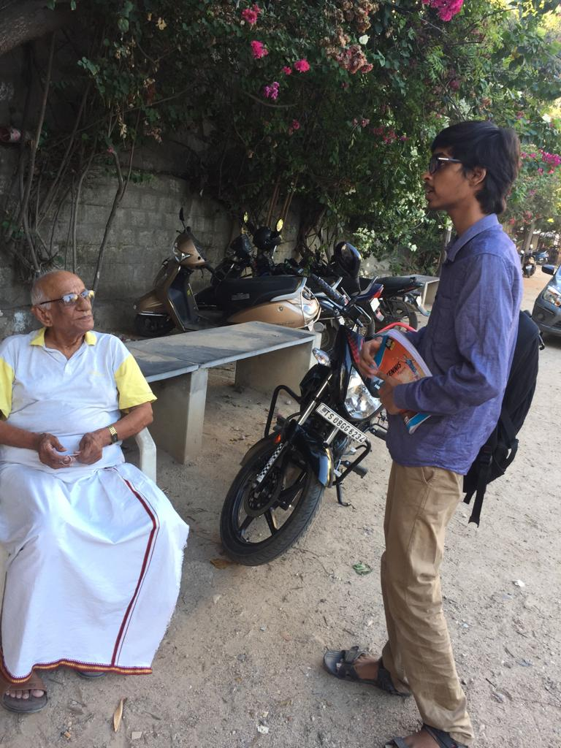
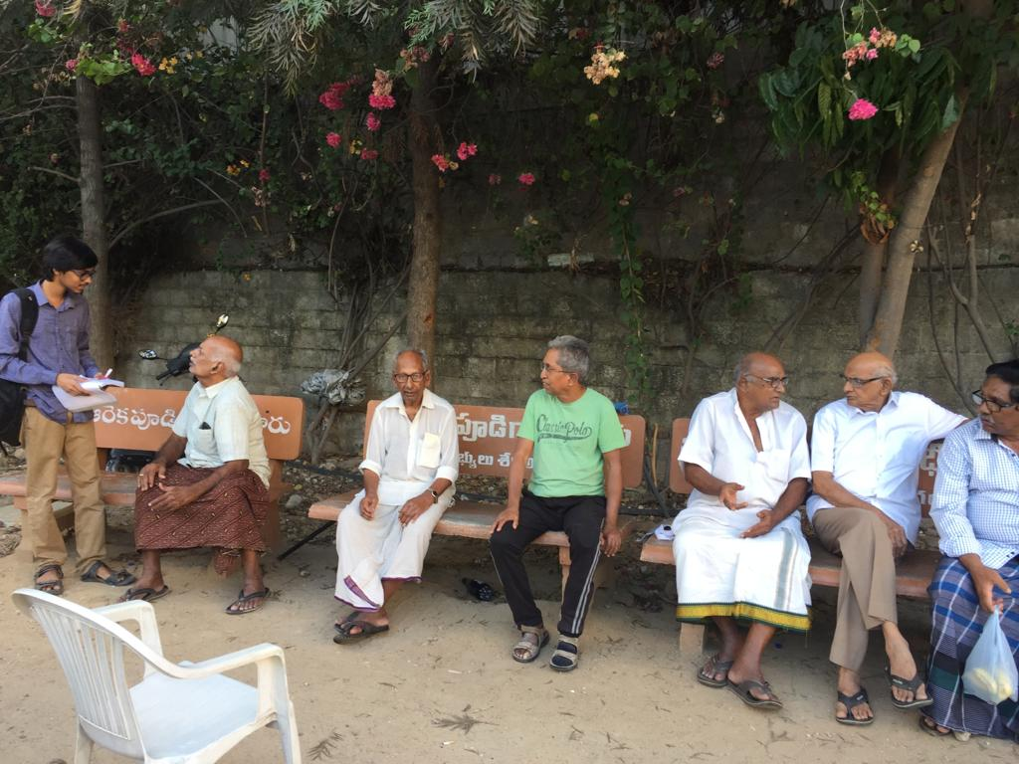
SURVEYS AND RESEARCH DONE

Slide 11
REVENUE MODEL
The revenue can be generated by selling the Band to the customer.
The Selling Price of the product will be around 3000 INR.

Slide 12
FINANCIALS
Presently the making price of the prototype is estimated around 4500 INR. It can be minimized by using embedded system.
Our month-wise revenue will be around 5 lakhs (It’s an assumption).

Slide 13
TEAM
1. Santosh Sanjeev
Team Leader
Skills : IoT, ML and Research
Worked on Integration
Research on fall prevention
2. L. Swetha Srilakshmi
Skills : IoT, IBM Cloud and MIT App Inventor
Worked on Remainder setting and Integration.
Visited old age home.
3. Suhas Gangireddy
Skills : IoT ,Raspberry Pi
Worked on Gesture communication
Visited old age home.
4. L. Pravalika
Skills : IoT, IBM Cloud and MIT App Inventor
Did market research
Visited old age home.

Slide 14
ASK
With the money we get from selling this product we would further add some more features in the product and develop it .
THANK YOU
TEAM - CREATIVE BRAINIACS

